Slide 1
Chapter 2
Web Development Using HTML
Notes:
Lecture slides prepared for “Computer Organization and Architecture”, 10/e, by William Stallings, Chapter 2 “Performance Issues”.

Slide 2
Objectives
After success completion of the chapter you will be able to:
Identify the core web development technologies
Understand the HTML document structure and contents models.
Identify and use HTML elements and attributes
Build website using HTML

Slide 3
Chapter 2 Part 4
HTML Elements
(Designing a Web Form)

Slide 4
2. Working with Web Form
Web form
Allows users to enter data that can be saved and processed.
Common way to accept user input (collect some data from the site visitor)
E.g. user registration – capture user info like name, address, credit card, etc.
It will post the data captured from user to a back-end application such as CGI, ASP Script or PHP script etc. which will perform required processing on the passed data based on defined business logic inside the application.
Allows the creation of interactive websites for user feedback
The <form> HTML element
Represents a web document section containing interactive controls for collecting and submitting information.

Slide 5
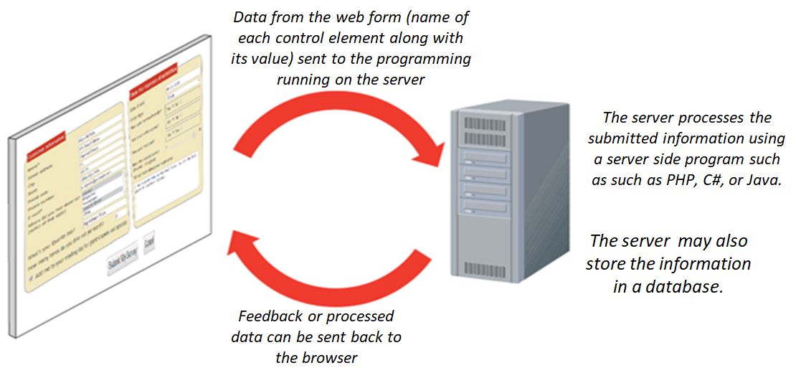
Cont’d
Interaction between the web form and the server

Slide 6
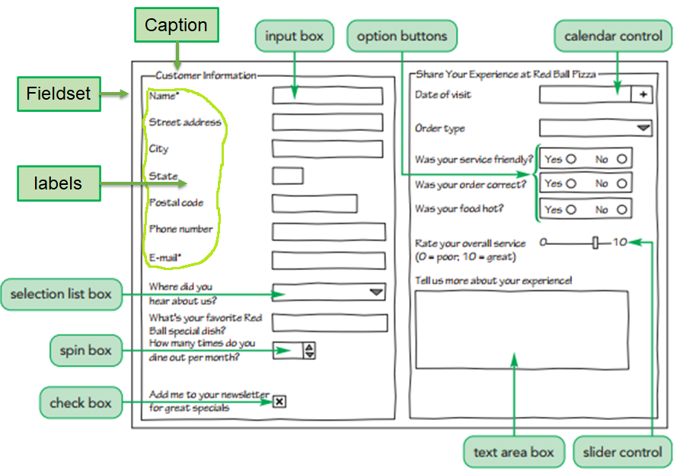
Cont’d
Inside the web form
The web form can contain one or more of the following
<input> element
<textarea> element
<button> element
<select> element
<option> element
<optgroup> element
<fieldset> element
<legend> element
<label> element
<output> element
<datalist> element
<progress> element
<meter> element

Slide 7
Cont’d
Form control elements
These are the objects that allow a user to interact with a form.
Each data entry control element is associated with a data field that stores the data values supplied by a user.
Types of controls
Text Input boxes
Single line input
Multi-line input
Password input
Choice/Selection
Selection lists
Radio buttons
Check boxes
Widget elements
Spin boxes
Slider controls
Calendar controls
Color pickers

Slide 8
Cont’d
(a) Creating Web forms
Web forms are marked using the form element
<form id=“text” attributes>
form control elements goes here
</form>
id attribute used to uniquely identifies the form
attributes specify additional attributes of the form
Some of the form attributes control the behavior during form submission.
A form element can be placed anywhere within the body of a page
Forms also can contain other web page elements such as tables, paragraphs, inline images, and headings

Slide 9
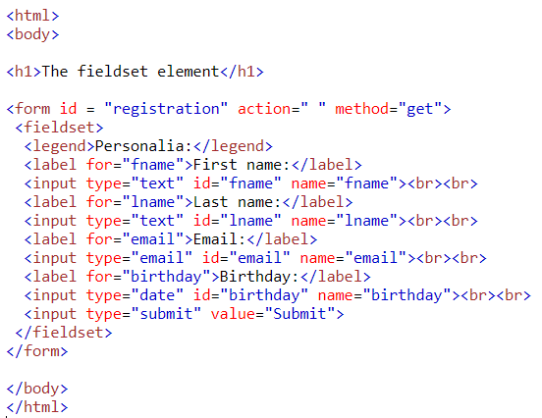
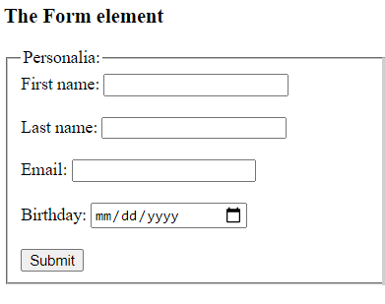
Cont’d
Example:

Slide 10
Cont’d
Most common form attributes
Attribute | Value | Description
action | URL | Specifies where to send the form-data when a form is submitted (provide the location of web server program)
method | get / post | Specifies the HTTP method to use when sending form-data
novalidate | Novalidate | Specifies that the form should not be validated when submitted
accept-charset | character_set | Specifies the character encodings that are to be used for the form submission
autocomplete | On / off | Specifies whether a form should have autocomplete or not
name | String | The name of the form. The value must be unique among the form elements and also must not be the empty
target | _blank / _self / _parent / _top | Specifies where to display the response that is received after submitting the form

Slide 11
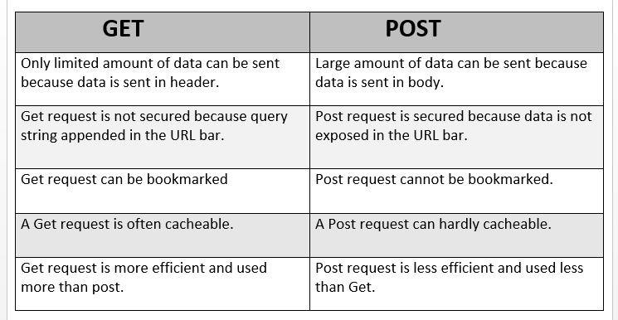
Cont’d
GET method Vs. POST method

Slide 12
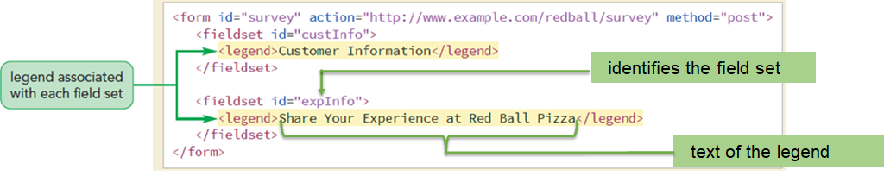
Cont’d
(b) Grouping Form Control Elements
Field set:
Groups fields (control elements) that share a common purpose
Field sets are created using the fieldset element
Legend:
Describes the content of a field set using the legend element
Contains only text and no nested elements
By default, it placed in the top-left corner of the field set box and can be moved to a different location using the CSS positioning styles

Slide 13
Cont’d
(c) Form Input Element
The <input type=" "> is an important element of HTML form.
It is the most commonly used element to create interactive controls for web-based forms in order to accept data from the user.
A wide variety of the types of input data and control widgets are available, depending on the device and user agent.
Syntax:
<input name=“name” id=“id” type=“type” />
Name attribute – provides the name of the data field associated with the control
id attribute – uniquely identifies the control in which the user enters the value
type attribute - indicates the input type (data type) of the field

Slide 14
Cont’d
type=" " | Description
text | Defines a one-line text input field
password | Defines a one-line password input field
radio | Defines a radio button which allows select one option
checkbox | Defines checkboxes which allow select multiple options form.
file | Defines to select the file from device storage.
submit | Defines a submit button to submit the form to server.
reset | Defines a reset button to reset all values in the form.
button | Defines a simple push button, which programmed to perform a task on an event
image | Defines a graphical submit button.
HTML Input Types
The "type" attribute of input element can be various types, which defines data field.
List the types of <input> element given in the table.

Slide 15
Cont’d
HTML5 added new types on <input> element
type=" " | Description
color | Defines an input field with a specific color.
date | Defines an input field for selection of date.
datetime-local | Defines an input field for entering a date without time zone.
email | Defines an input field for entering an email address.
month | Defines a control with month and year, without time zone.
number | Defines an input field to enter a number.
url | Defines a field for entering URL
week | Defines a field to enter the date with week-year, without time zone.
search | Defines a single line text field for entering a search string.
tel | Defines an input field for entering the telephone number.

Slide 16
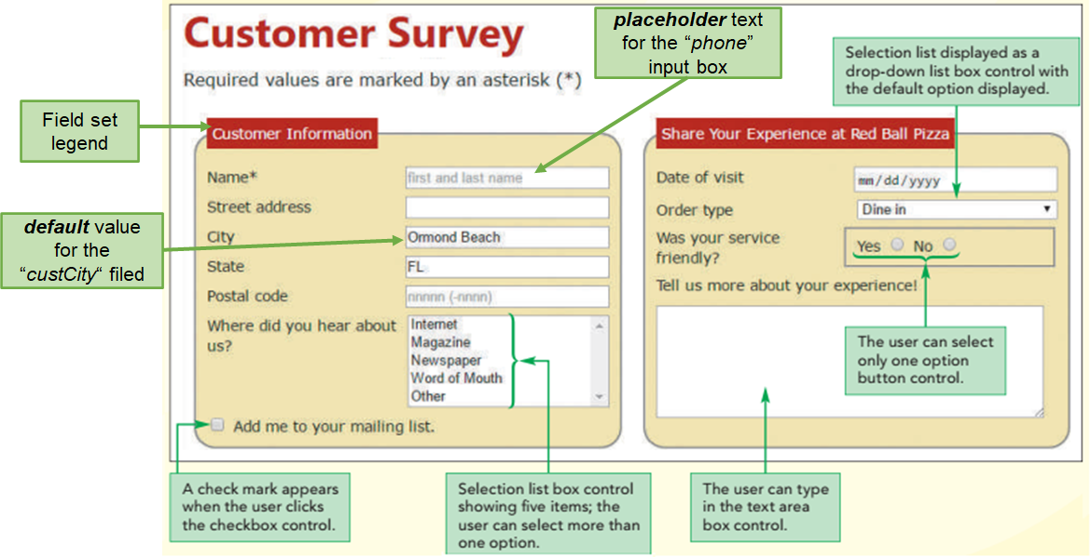
Cont’d
Example: Design and layout of the survey form

Slide 17
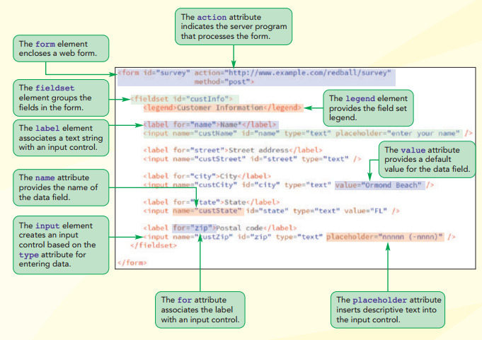
Cont’d
Examine the form design code
The for attribute
When used with the <label> elements specifies which form element a label is bound to

Slide 18
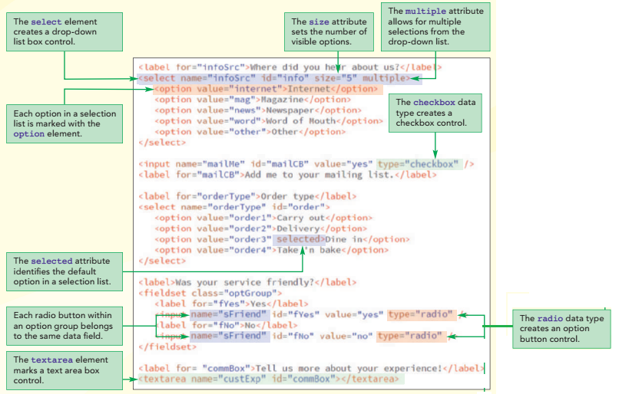
Cont’d
Examine the form design code

Slide 19
Cont’d
Common Attributes to all <input type = “ “>
Attribute | Description
autocomplete | Hint for form autofill feature
autofocus | Automatically focus the form control when the page is loaded
disabled | Define whether the form control is disabled
form | Associates the control with a form element
name | Name of the form control. Submitted with the form as part of a name/value pair.
value | The initial value of the control.
readonly | Boolean. The value is not editable
required | Boolean. A value is required or must be check for the form to be submittable

Slide 20
Cont’d
Attributes that applied to “image” and “submit” to <input type = “ “>
Attribute | Description
formaction | URL to use for form submission
formenctype | Form data set encoding type to use for form submission
formmethod | HTTP method to use for form submission
formnovalidate | Bypass form control validation for form submission
formtarget | Browsing context for form submission
height, width (img only) | Same as height, width attributes for <img>;
src, alt (img only) | Same as src, alt attributes for <img>;

Slide 21
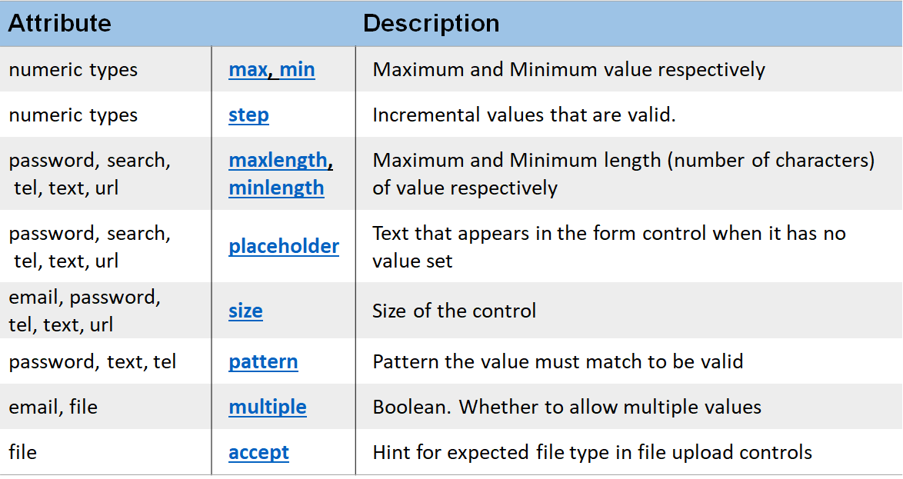
Cont’d
Other Attributes

Slide 22
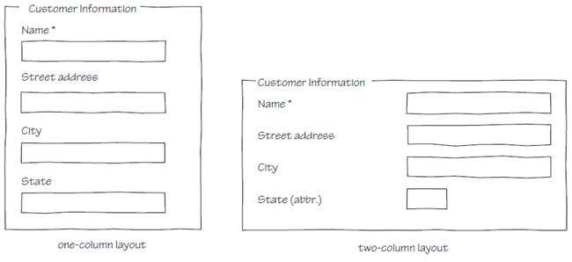
Cont’d
(d) Designing a Form Layout
There are two general layouts
Labels are placed directly above the input controls
Labels and controls are placed side-by-side

Slide 23
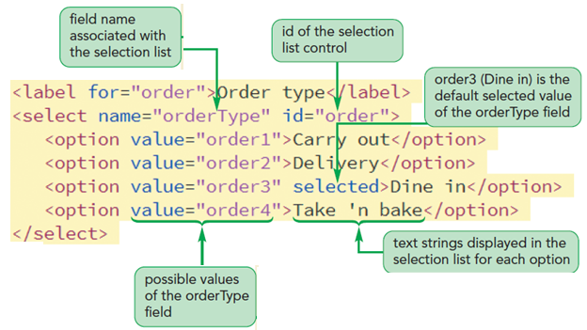
Cont’d
(e) Creating a Selection List
A selection list is a list box that presents users with a group of possible values for the data field
The list is created using the select and option elements

Slide 24
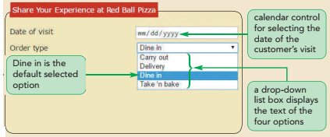
Cont’d
By default, a selection list appears as a drop-down list box
To display a selection list as a scroll box, use the size attribute
Multiple items selection
Two ways for users to select multiple items from a selection list
For non-contiguous selection, press and hold the Ctrl key while making the selections
For contiguous selection, select the first item, press and hold the Shift key, and then select the last item in the range

Slide 25
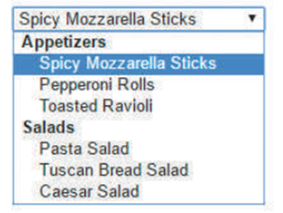
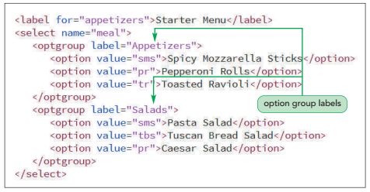
Cont’d
(f) Grouping Selection Options
The selection list options can be organized by placing them in option groups using the optgroup element

Slide 26
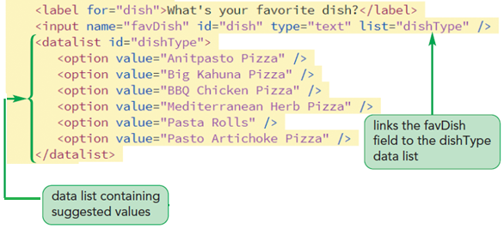
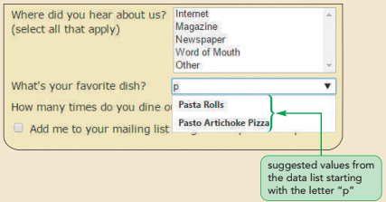
Cont’d
(g) Data Lists - suggesting options
Data list is a list of possible data values that a form field can have.
It defined using the datalist element

Slide 27
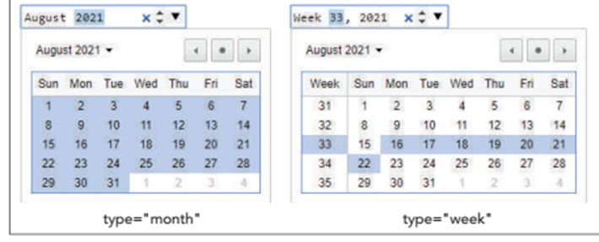
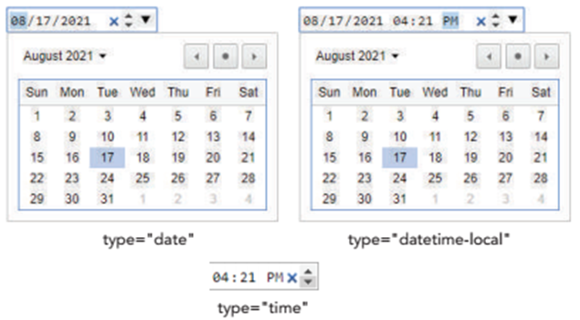
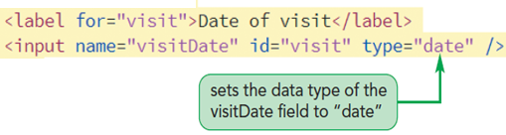
Cont’d
(h) Entering Date and Time Values
Date and time fields ensure that users enter data in the correct format
Indicated using type attributes: date, time, datetime-local, month, and week

Slide 28
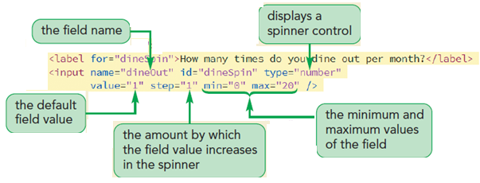
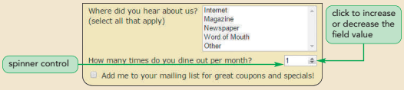
Cont’d
(i) Spinner control - entering numeric values
Spinner control: Displays an up or down arrow to increase or decrease the field value by a set amount
To create a spinner control, apply the input element using the number data type

Slide 29
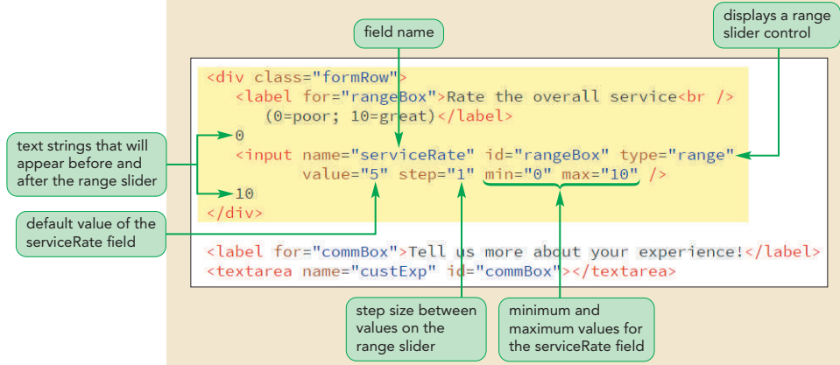
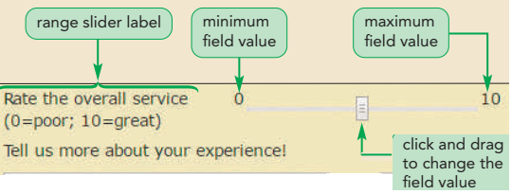
Cont’d
(j) Creating a range slider control
A slider control limits a numeric field to a range of possible values
To create a slider control, apply the range data type in the input element

Slide 30
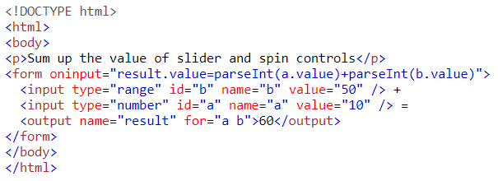

Cont’d
(k) The Output element
A container element into which a site or app can inject the results of a calculation or the outcome of a user action.
The <output> tag is a newly added tag and was introduced in HTML5.
Example 1:

Slide 31
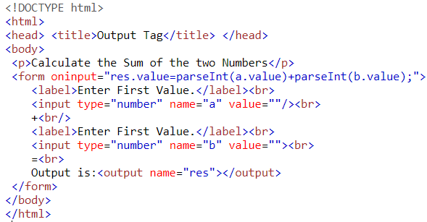
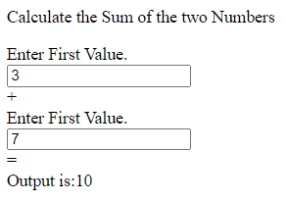
Cont’d
Example 2:

Slide 32
Cont’d
(l) The progress and meter element
Progress element
Displays an indicator showing the completion progress of a task, typically displayed as a progress bar.
It is mostly used to show the progress of activity like a file uploading or downloading on the web.
Meter element
Used to measure data within a given range.
It represents either a scalar value within a known range or a fractional value.
It is also known as a gauss.
It should be used to display disk usage, voting population etc.

Slide 33
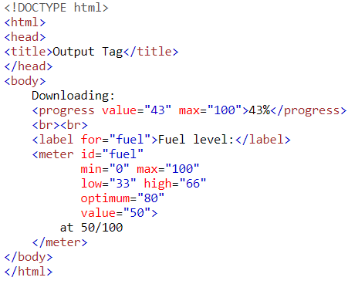

Cont’d
Example:
Value - defines that how much work the task has been completed.
Max - defines that how much work the task requires in total.
Value - a mandatory attribute which is used to specify a value in numbers (integer or floating point)..
High and low - specifies a range that is considered as high and low value respectively.
Max and min - specifies the maximum and minimum value defined in the range.
Optimum - specifies the optimum value for the gauge .

Slide 34
Cont’d
(m) Working with Form Buttons
Form buttons: A type of form control that performs an action
Actions performed
Run a command from a program linked to the web form
Submit the form to a program running on the web server
Reset the form fields to their default values
Types of form buttons
Command button
Submit button
Reset button
Custom button

Slide 35
Cont’d
Submit and Reset button
Submit button - submits a form to the server for processing when clicked.
Reset button - resets a form, changing all fields to their default values and deleting any field values that a user has entered
Created using input elements with the type attribute set to “submit” and “reset” respectively.
Example:
<input value=“text” type=“submit” />
<input value=“text” type=“reset” />
where text is the string that appears on the button

Slide 36
Cont’d
Command button
Runs a program that affects the content of a page or the actions of a browser
Created using the input element with the type attribute set to button
e.g. <input value=“text” onclick=“script” type=“button” />
text - string that appears on the button
script - the name of the program code that is run when the button is clicked
Custom button
Appearance of a command, submit, and reset button is determined by the browser
For more control over a button’s appearance use the button element
E.g. <button type=“text”> content </button>
Where type attribute specifies the button type and the content are HTML elements placed within the button

Slide 37
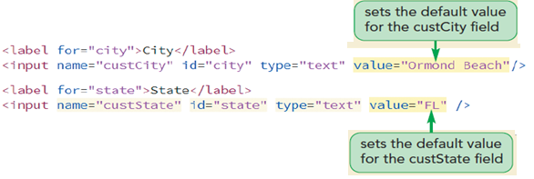
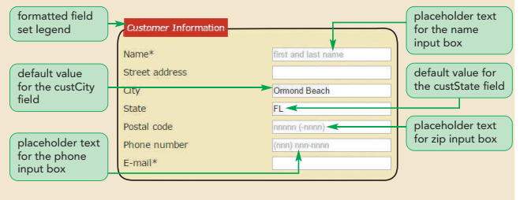
Cont’d
Defining default value and placeholder
Default value
Specified using the value attribute
Placeholder
A text that appear within a form control, providing a hint about the kind of data that should be entered into a field
Defined using the placeholder attribute

Slide 38
3. Validating a Web Form
Validation: Process of ensuring that a user has supplied valid data
Types of validation
Server-side validation – validation occurs on the web server
Client-side validation – validation occurs in the user’s browser
What to validate?
Identifying Required Values
The first validation test is to verify if data is supplied for all the required data fields
Add the required attribute to the control to identify the required data fields
Defining the Length of the Field Value
For example the syntax to define the maxlength attribute is <input maxlength=“value”/>
Example: <input name=”custZip” maxlength=“5” />
The maxlength attribute does not distinguish between characters and digits

Slide 39
Validating a Web Form
Validating Based on Data Type
A form fails the validation test if the data values entered into a field do not match the field type
Example:
Entering a nonnumeric data for data field with the number type
Providing invalid email or url types that does not match the format of a URL
Testing for a Valid Pattern
To test whether a field value follows a valid pattern of characters, test the character string against a regular expression
Regular expression or regex is a concise description of a character pattern
To validate a text value against a regular expression, add the pattern attribute to the input element.
Example: see next slide

Slide 40
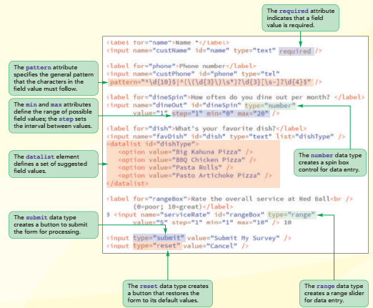
Cont’d
Data Validation
(examine the code)

Slide 41
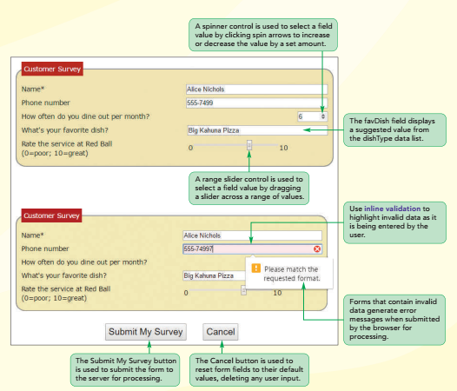
Cont’d
Data Validation
(look on the screen)

Slide 42
Summary
Whenever you want to collect information from visitors you will need a form, which lives inside a <form> element.
Information from a form is sent to web server in name/value pairs.
Each form control is given a name, and the text the user types in or the values of the options they select are sent to the server.
HTML5 introduces new form elements which make it easier for visitors to fill in forms.
Form buttons are a type of form control that performs an action.
The form buttons are control, submit, reset and custom button.
Form validation is a process of ensuring that a user has supplied valid data,
The validation can be performed either on the client or server side.

Slide 43
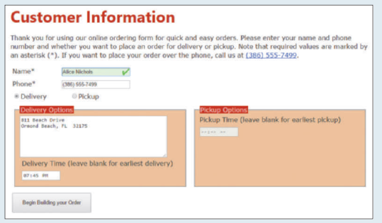
Exercise 2: Working with Form

Slide 44
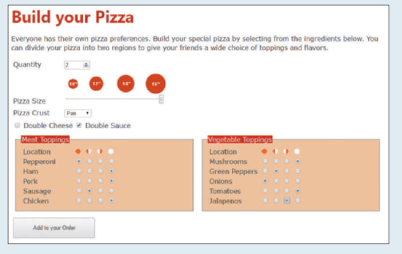
Exercise 3: Working with Form

